Slide 1


Irrigation Scheduling Based on Wireless Sensors Output and Soil-Water Characteristic Impact on Yield and Recovery of Sugarcane
Presented By: Azeem Haider (Ph.D)

Slide 2
INTRODUCTION:
Depending on the growth stage, sugarcane biomass contains 60–80% water.
It is estimated that sugarcane requires 1500–2000 mm of annual rainfall for optimum production (http://www.fao.org)
Real-time soil moisture sensors have been used for a variety of agricultural and environmental applications, including water management and irrigation scheduling (Jabro et al. 2017; Leib et al. 2013)
WATERMARK soil-moisture sensors can provide continuous real-time measurements of water potential at various depths within the soil profile to schedule irrigation
We selected smart soil-moisture sensors (SSMS) in this study due to their simplicity, accuracy, ease of installation, and reduced labor requirement, maintenance, soil disturbance and relative affordability, compared to other soil-moisture sensors (Vellidis et al. 2008; Nollz et al. 2013)
These characteristics, coupled with the wireless capability, make SSMS sensors more suitable for irrigation planning and management
This paper reports on a project aimed at assessing the impact of irrigation scheduling based on wireless sensors and soil-water characteristics on sugarcane yield and recovery

Slide 3
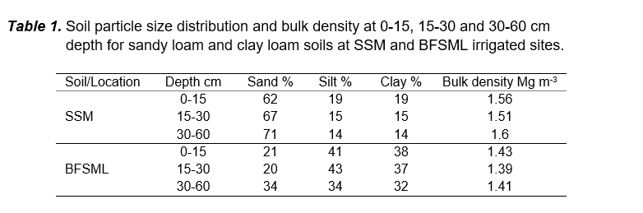
MATERIALS & METHODS:
Sites and soil description
The first site was at Safina Sugar Mills (SSM), Chiniot, Pakistan. The soil is classified as a very deep well-drained sandy loam in a level position in the landscape.
The second site was near to Baba Farid Sugar Mills (BFSML), Okara, Pakistan. The soil is leveled well-drained clay loam.
Particle size analysis and bulk density for these soils are shown in Table 1. Irrigation amounts were applied as needed using electric pumps.

Slide 4
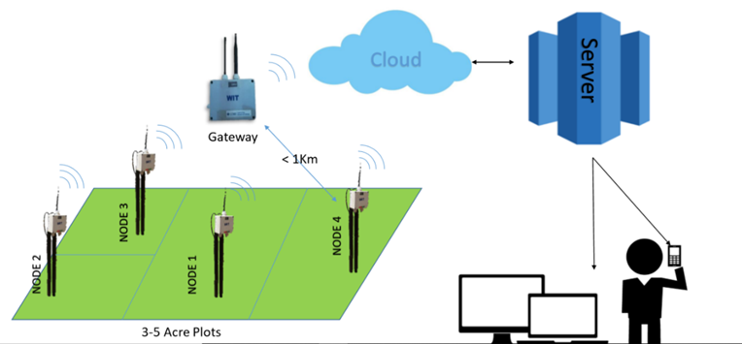
MATERIALS & METHODS (Cont.):
Gateway and node features
The LoRa Receiver operated at 433MHz for GPRS/GSM data upload. It had a range up to 1 km (tested at 800 m) (Figure 1).
Figure 1. Smart Soil Moisture Sensor (SSMS) system architecture.

Slide 5
MATERIALS & METHODS (Cont.):
Irrigation Scheduling
Soil water potential values, measured at various depths, were averaged using the weighted mean to reflect the content of the rooting zone.
Soil-water initiated irrigation events when any of the SSMS readings approached the threshold level for a sugarcane crop at either location.
Installation
Sensors were buried in the soil at depth of 15-20 cm and 15-30 cm where most of the sugarcane roots were present. Two wireless SSMS nodes were installed at the SSM site and one node at the BFSML site.
Soil-moisture contents, at field capacity and permanent wilting points, were determined from soil-water characteristic curves and were approximately 26% and 14% for the sandy loam, and 28% and 16% for a clay loam, respectively.
Harvesting
The sugarcane within designated plots at the trial sites was harvested manually 13 months after planting and weighed.
The number of irrigations and amount of rainfall at each site were determined with and without the SSMSs.

Slide 6
RESULTS:
Soil moisture classes and ‘threshold’ values (Figure 2) were determined for the sandy loam and clay loam soils. Two scenarios were presented for irrigation scheduling for sugarcane grown on sandy loam and clay loam soils at the two locations.
Real-time soil matric potentials from SSMS sensors placed at 15-20 cm and 25-30 cm depths, cumulative rainfall, and cumulative irrigation during the growing season for sandy loam and clay loam soils are shown in Figures 3-5. Soil matric potentials from SSMS readings in both soils decreased with irrigation and rainfall events.
Our findings, coupled with previous research studies, indicated that soil-moisture sensors were reliable and useful tools for measuring soil-water potentials under various field conditions and scheduling irrigation more efficiently (Irmak et al. 2001; Nollz et al. 2013).
Our findings are consistent with those of Vellidis et al. (2008) and Mafuta et al. (2013) who reported that smart sensors have real potential to monitor accurately the moisture content in soils and determine irrigation management practices.

Slide 7
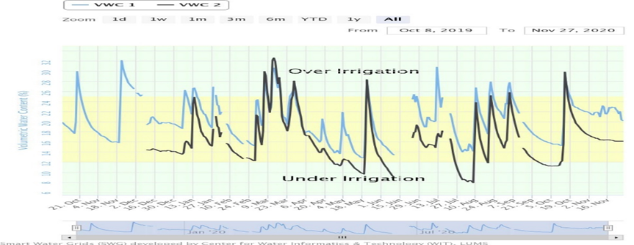
Figure 2. Different water levels in soil-water content (Yonts et al. 2011)
Figure 3. Soil matric potential from the SSMS sensors at soil depths of 15-20 cm and 25-30 cm, cumulative rainfall, and irrigation during the 2019-20 season for the sandy loam soil.

Slide 8
Figure 4. Soil matric potential from the SSMS sensors at soil depth of 15-20 cm and 25-30 cm, cumulative rainfall, and irrigation during the 2020-21 season for the sandy loam soil.
Figure 5. Soil matric potential from SSMS sensors at soil depth of 15-20 cm, cumulative rainfall, and irrigation during the 2020-21 season for the clay loam soil.

Slide 9
RESULTS (Conti.):
At SSM, sugarcane cultivars CPF-251 (US-633) planted in September of the 2019/20 growing season and February of the 2020/21 growing season with SSMS sensors received two and three irrigation events fewer than the sugarcane without sensors, respectively (Table 2).
This resulted in 17% higher cane yield and 0.16% higher sugar recovery (Table 3) calculated as averages for the September and February plantings when sensors were used compared to where no sensors were installed.
At BFSML, sugarcane cultivar CPF-249 planted in February of the 2020/21 growing season with SSMS sensors received three fewer irrigations compared to the crop grown without sensors (Table 2).
This resulted in 4% higher cane yield (Table 3) and 0.35% higher sugar recovery (Table 4) with sensors compared to sugarcane without sensors.
In both cases, the higher cane and sugar recovery was assumed to be the result of a combination of higher moisture availability and better soil aeration, better access to water soluble nutrients in all the stages of cane growth, and water availability based on the crop demand.

Slide 10
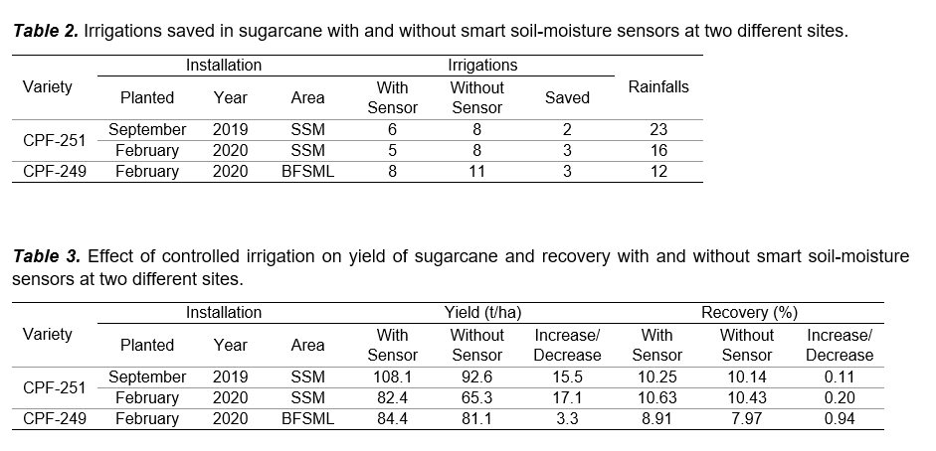
RESULTS (Conti):

Slide 11
DISCUSSION & CONCLUSION:
Our results showed that SSMS sensors provided practical tools for monitoring soil-moisture status in the root-zone for irrigation scheduling in sugarcane plots, for both sandy loam and clay loam soils at the two locations.
Whether data-logging is wireless or manual, SSMS sensors can be used to monitor soil-water potential status effectively in the crop root zone and determine efficient irrigation events by setting two matric potential thresholds using soil-water characteristics.

Slide 12
ACKNOWLEDGEMENT & REFERENCES:
Lahore University of Management Sciences, Pakistan for installing the SMSS sensors, setting up the wireless assembly system, and monitoring soil moisture sensors throughout the growing season.
Irmak S, Haman DZ. 2001. Performance of the Watermark granular matrix sensors in sandy soils. Applied Engineering in Agriculture 17: 787–795.
Jabro JD, Stevens WB, Iversen WM. 2017. Field performance of three real-time moisture sensors in sandy loam and clay loam soils. Archives of Agronomy and Soil Science 64: 930–938.
Leib BG, Jabro JD, Matthews GR. 2013. Field evaluation and performance comparison of soil moisture sensors. Soil Science 168: 396–408.
Mafuta M, Zennaro M, Bagula A, et al. 2013. Successful deployment of a wireless sensor network for precision agriculture in Malawi. International Journal of Distributed Sensory Networks 2013: 150703.
Nollz R, Kammerer G, Cepuder P. 2013. Calibrating soil water potential sensors integrated into wireless monitoring network. Agricultural Water Management 116: 12–20.
Vellidis G, Tucker M, Perry C, Kvien C, Bednarz C. 2008. A real-time wireless smart sensor array for scheduling irrigation. Computers and Electronics in Agriculture 61: 44–50.

Slide 13





+92 321 4048133
Azeem.haider@almoiz.com

